Slide 1

Team Details
Team name: Error 404 Sleep Not Found
Team leader name: Manas Agnihotri
Problem Statement: Open Innovation

Slide 2

Brief about your solution and problem statement addressing
1. The "Complexity Gap" for Buyers
Most modern e-commerce platforms are cluttered with overwhelming ads and complicated multi-step checkouts. This makes it difficult for low-educated or non-tech-savvy users to navigate, leading to frustration and abandoned purchases.
2. The "Technical Burden" for Local Sellers
Small-scale merchants often struggle with "Management Fatigue". Existing tools for inventory tracking and order processing are often too complex, requiring sellers to spend more time on paperwork than on their actual products.
3. Performance & Security Anxiety
Performance Lag: Slow interface feedback during shopping (like updating a cart) makes the platform feel unreliable.
Payment Fears: Users often abandon carts because they find the payment process confusing or worry that their passwords and financial data are not handled securely.

Slide 3
Opportunities
How different is it from any of the other existing ideas?
How will it be able to solve the problem?
1. Intuitive Shopping for Everyone
The buying process is designed with a "Visual-First" approach, using clear icons, color-coded buttons, and a simple step-by-step checkout that allows even a user with minimal technical knowledge or low education to complete a purchase easily.
2. Effortless Seller Management
Sellers can handle their entire business in a few clicks through an all-in-one dashboard that makes adding new products, tracking stock levels, and processing incoming orders as simple as using a social media app.
3. Secure Payments & Data Privacy
ShopEasy offers a one-touch payment experience with multiple secure options, protected by advanced encryption that keeps user passwords and personal data safe from unauthorized access.
4. Chatbot ShopEasy includes a chatbot that helps users find the right products instantly. Discover items faster without manually searching or filtering.

Slide 4
List of features offered by the solution
1. High-Speed Performance with Redis Caching
Instant Data Retrieval: Integrated Redis Caching to store frequently accessed data, drastically reducing database load and server response times.
Eliminating Lag: By caching product details and user sessions, we ensure the website remains lightning-fast even during high traffic.
2. Effortless Seller Empowerment with Real-Time Control Unified Seller Dashboard: Designed a streamlined control center where sellers can view their entire business—orders, inventory, and performance—at a glance without complex menus. One-Click & Real-Time Management: Inventory updates, product listings, and order tracking are handled through simple toggles and forms, with Socket.IO enabling live order notifications and status updates so sellers receive instant information without manual page refreshes.
3. Smart Recommendations with User Behavior Analysis Personalized Discovery: The platform intelligently analyzes user search history and browsing patterns to recommend relevant products tailored to individual preferences.
4. Shopping Assistant Product Search: An integrated chatbot allows users to find products using instead of manual searching or filtering. Guided Buying Experience: The chatbot assists users with product comparisons, suggestions, and quick answers, reducing decision fatigue and saving time.

Slide 5
Google Technologies used in the solution
1. Google Authentication (Identity Platform)
One-Tap Access: Integrated Google Auth to allow users to sign up or log in with a single click, removing the friction of remembering new passwords.
Trusted Security: Leverages Google’s enterprise-grade security protocols to ensure user accounts are protected against unauthorized access.
2. Google Maps API for Location-Based Checkout Accurate Address Detection: Integrated the Google Maps API to fetch precise user location and convert coordinates into a readable delivery address during checkout. Faster & Error-Free Ordering: With a single “Use my current location” action, users can auto-fill address details, reducing manual input, minimizing errors, and speeding up the overall ShopEasy checkout experience..

Slide 6
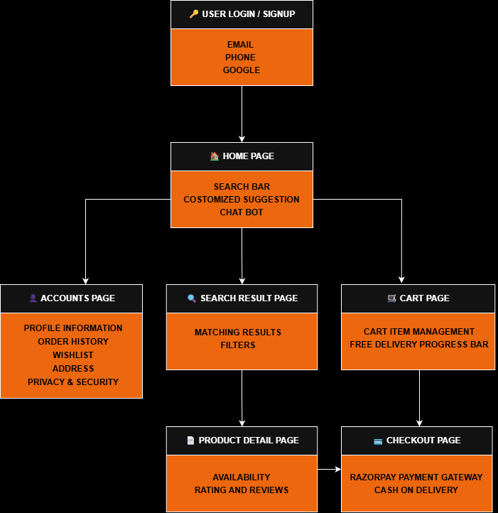
Process flow diagram or Use-case diagram

Slide 7
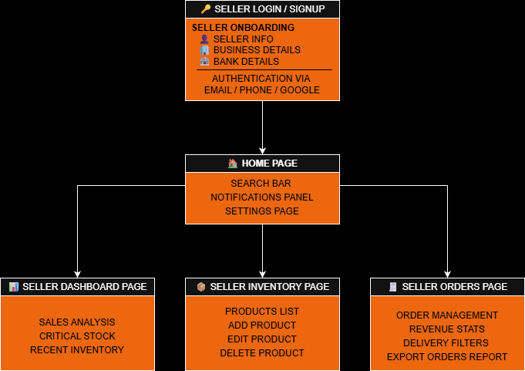
Process flow diagram or Use-case diagram

Slide 8
Tech Stack
Frontend
React.js: A component-based library used to build a dynamic, high-performance single-page application (SPA).
Tailwind CSS: A utility-first CSS framework that enables rapid UI development and consistent, responsive design.
React Router Dom: A routing library used to manage navigation and URL states in a single-page application.
Axios: The promise-based HTTP client used to communicate with your Backend API.
Backend
Node.js: The runtime environment that executes JavaScript on the server
Express.js: The web framework used to handle routing, middleware
MongoDB: A NoSQL document database designed for flexible, high-volume data storage.
Mongoose: An ODM library providing a schema-based solution to model application data.
Redis: An in-memory data store utilized as a high-speed caching layer to minimize database latency and accelerate data retrieval.
Socket.io: A specialized library for bidirectional, event-based communication to enable real-time updates between the server and the client.

Slide 9
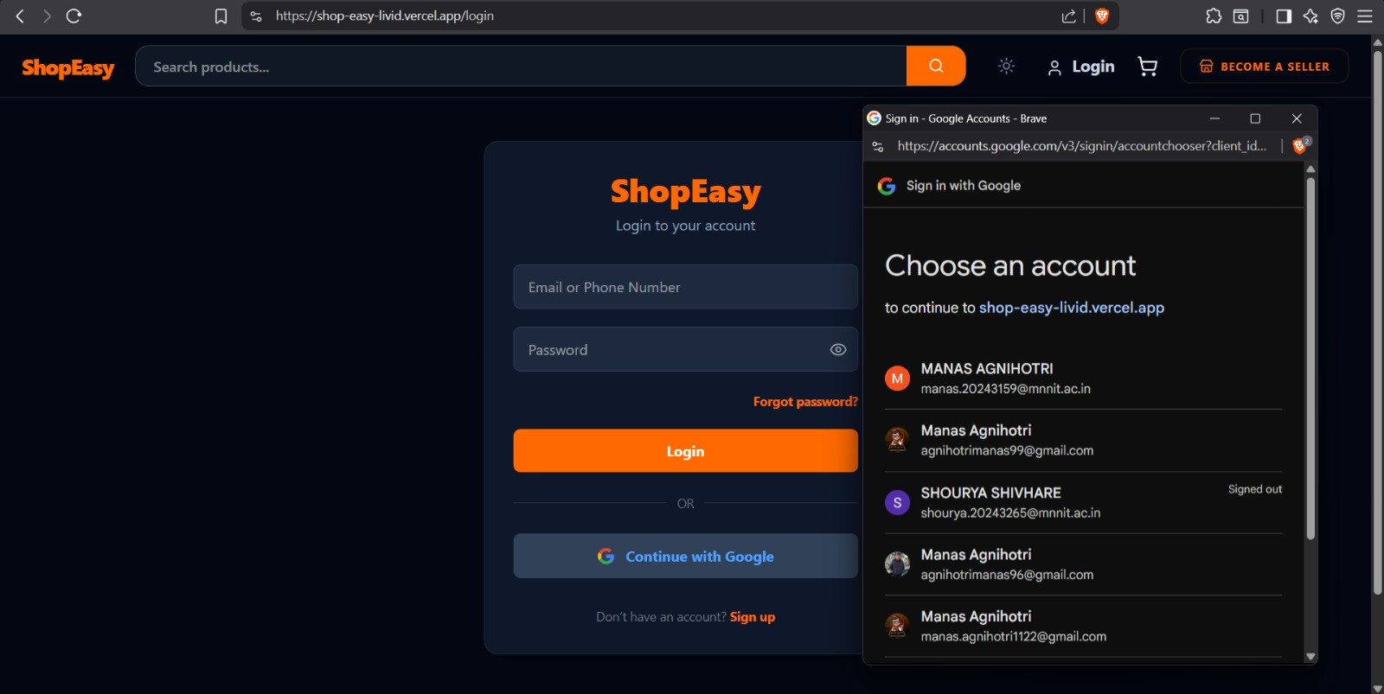
Snapshots of the MVP

Slide 10
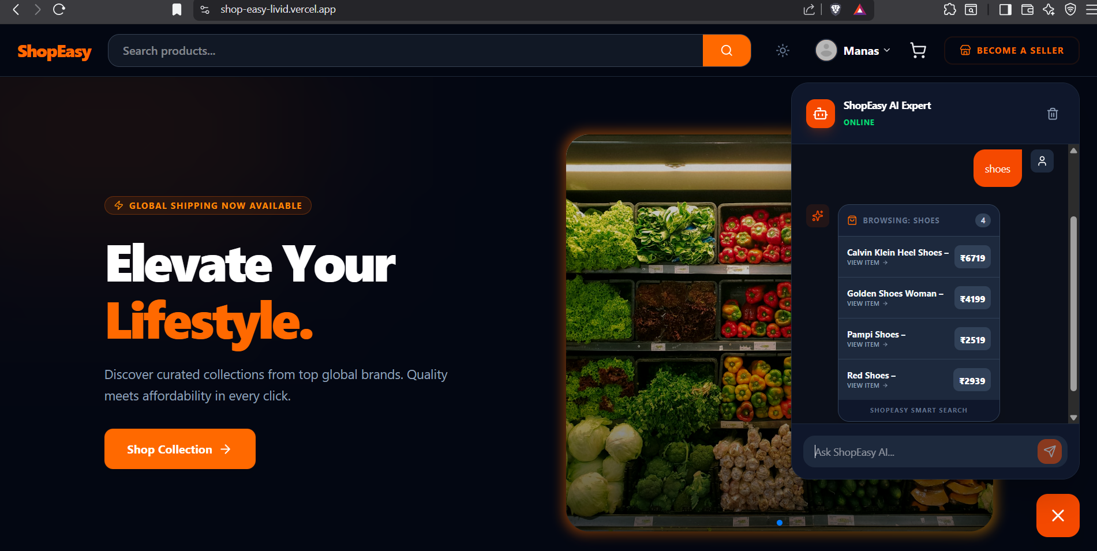

Slide 11
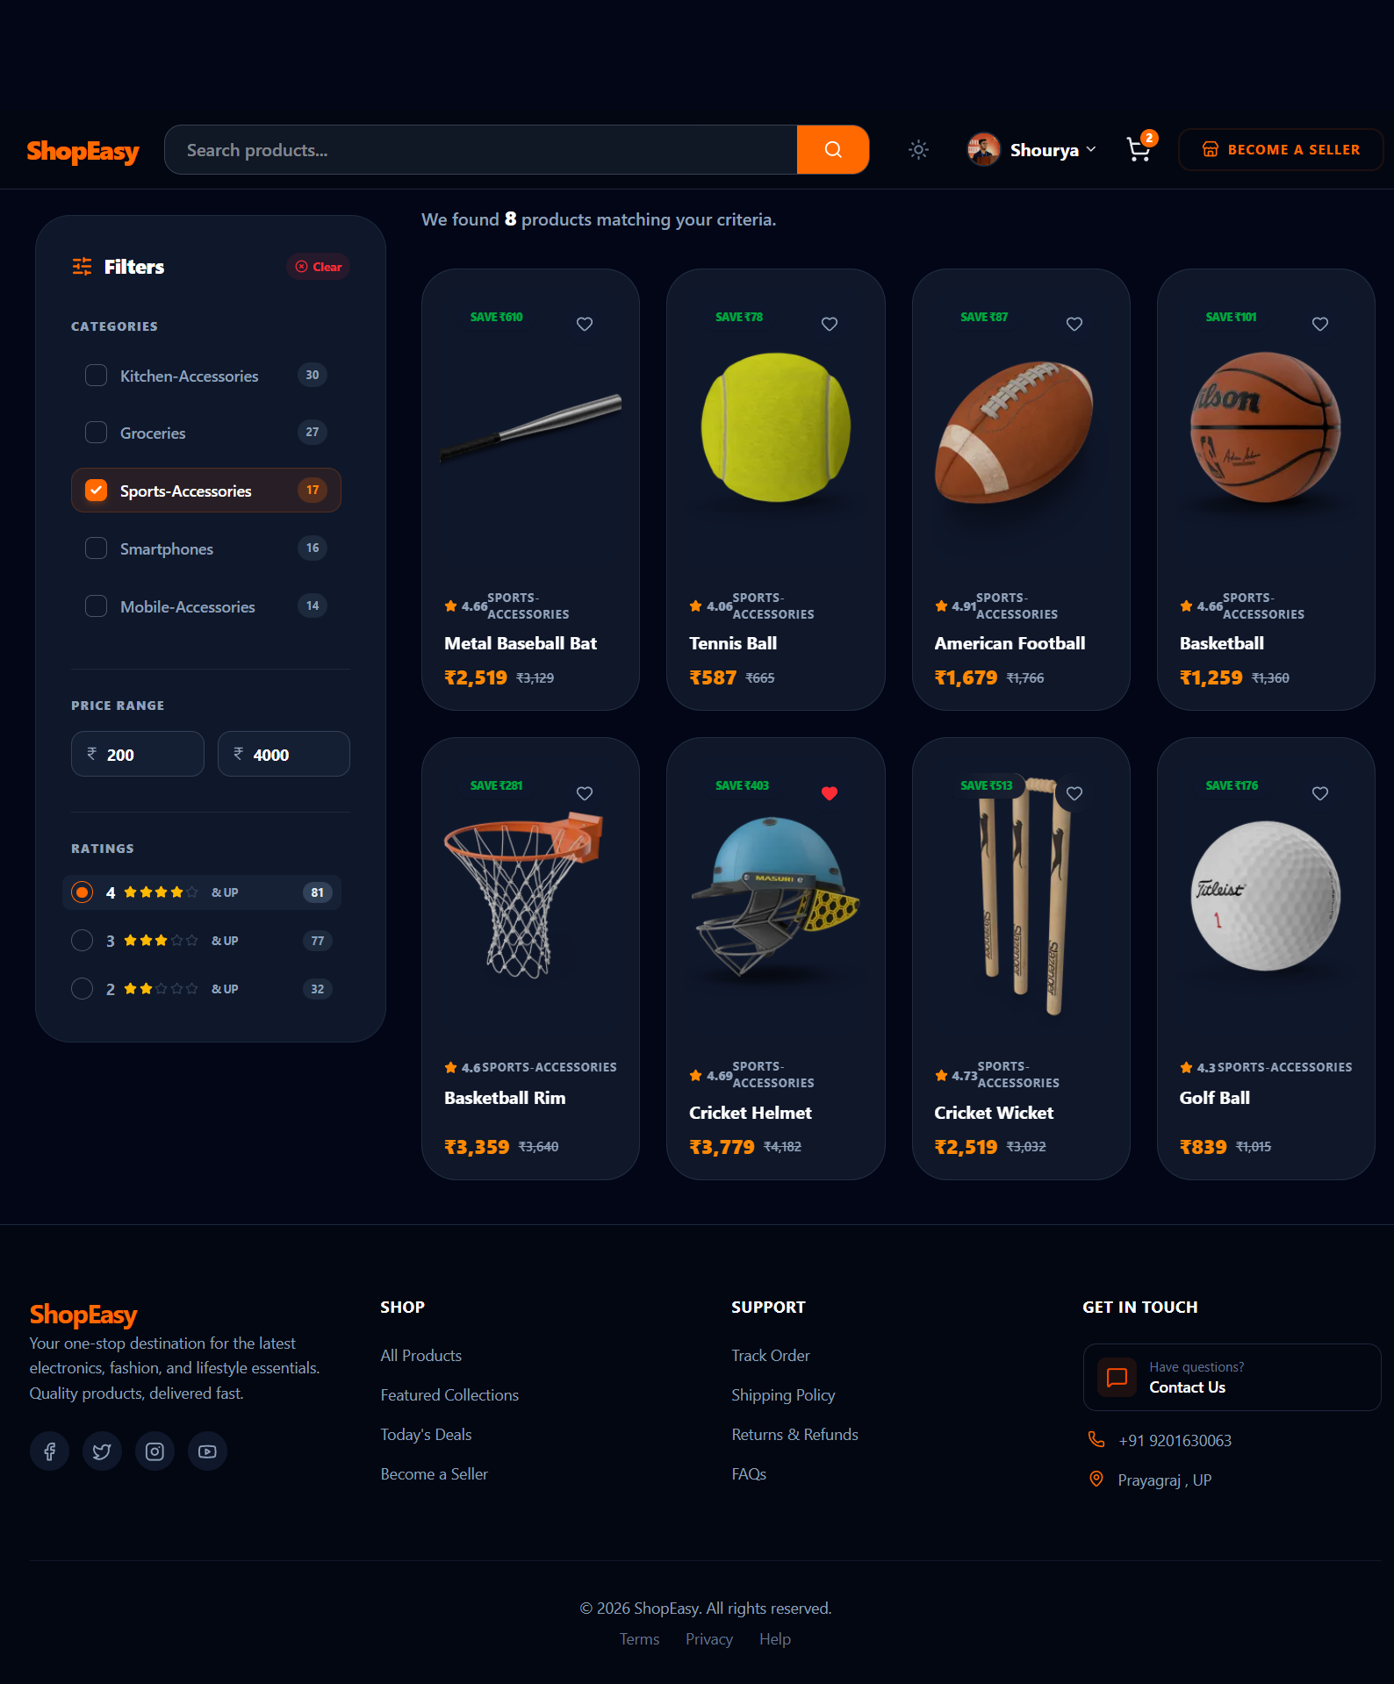

Slide 12
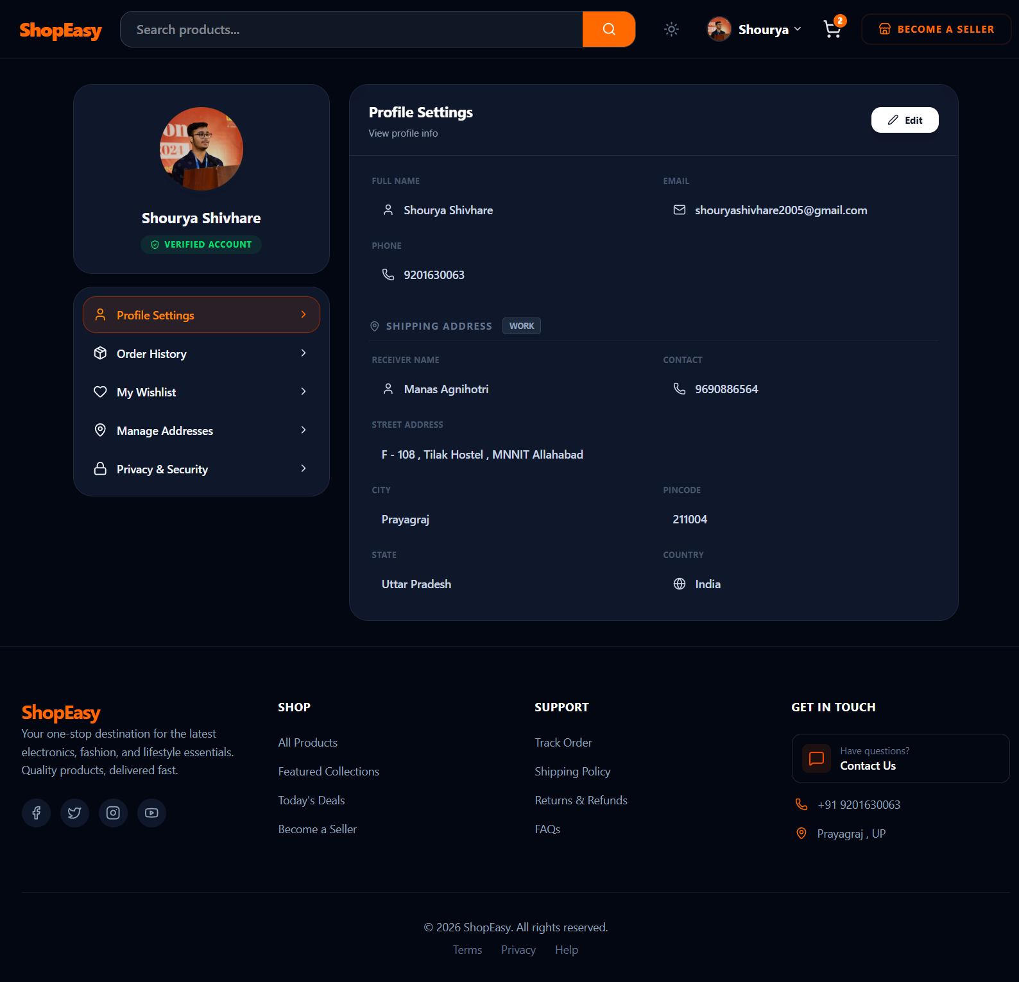

Slide 13
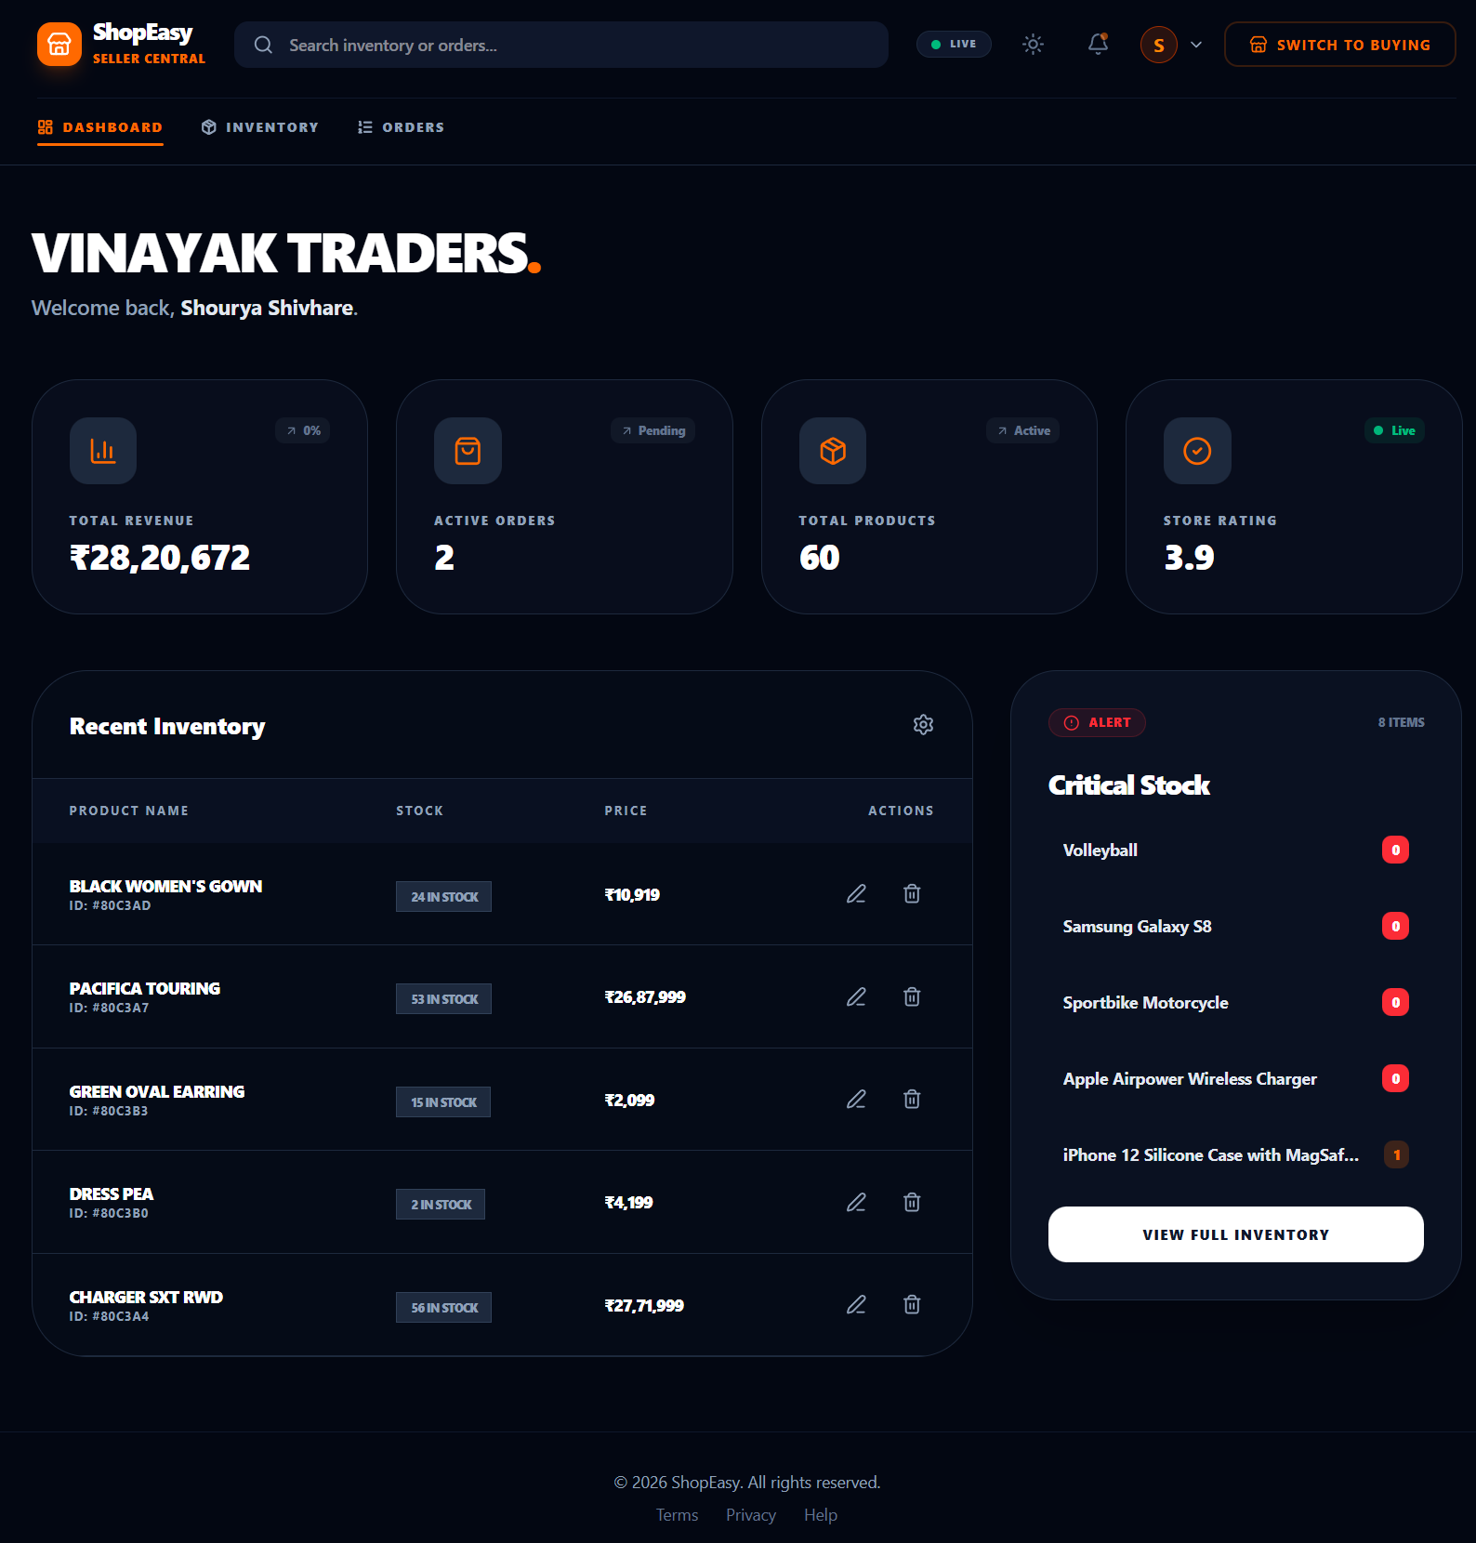

Slide 14
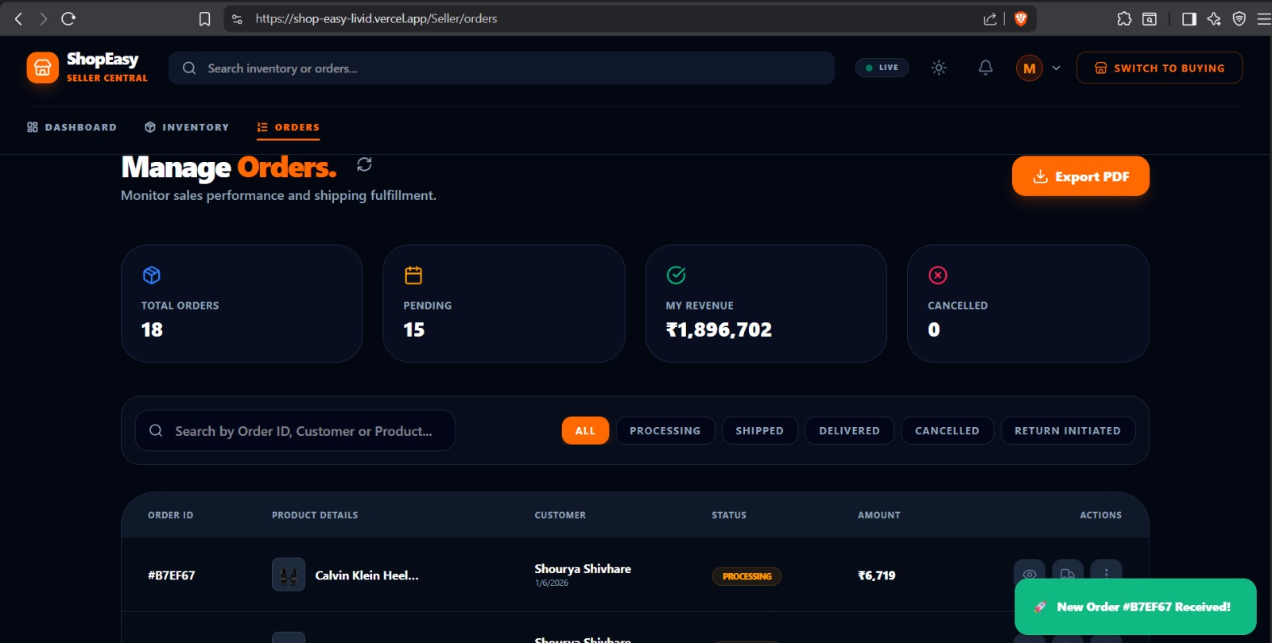

Slide 15
Additional Details/Future Development (if any)
1. AI-Powered Behavioral Recommendations
Predictive Search Intent: Using Natural Language Processing (NLP) to map broad queries like "summer party outfit" to specific product categories, moving beyond simple keyword matching to understand true shopper intent.
2. Smart Inventory & Price Optimization
Demand Forecasting: AI models that analyze sales trends to alert sellers when stock is likely to run out before it happens.
Dynamic Pricing: Automatically adjusting prices based on market demand, competitor pricing, and stock levels to maximize seller revenue.
3. Automated Content Generation for Sellers
One-Click Listings: Using AI to generate professional product descriptions and optimized titles from a single uploaded product image.
Smart Image Enhancement: Automatically removing backgrounds and improving lighting for seller-uploaded photos to maintain a premium UI.
4.Conversion-Driven Search Ranking
Sales-Velocity Ranking (Buying Ratio): Implementing a Learning-to-Rank (LTR) model that reorders search results based on the "Buying Ratio" (Conversion Rate). Products with higher historical sales-per-view are boosted to the top, ensuring users see products that are most likely to satisfy their purchase intent.

Slide 16
Provide links to your:
GitHub Public Repository (https://github.com/manasdevX/ShopEasy)
Demo Video Link (https://drive.google.com/file/d/15XV0SK08kflwiejQJ_insFnd8XfidkGf/view?usp=drive_link)
MVP Link(https://shop-easy-livid.vercel.app/)

Slide 17

Thank you!

